Slide 1


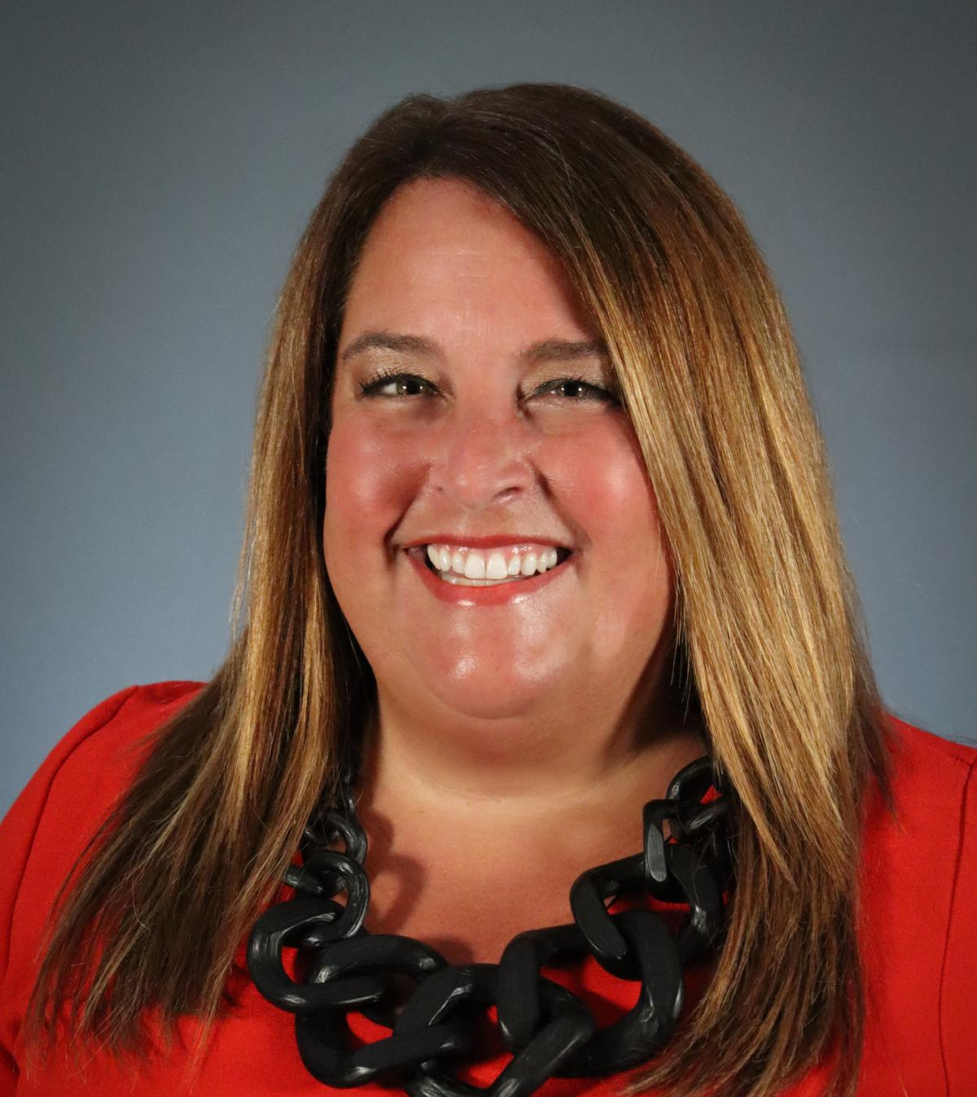
2025
ACTEA
UPDATE

Slide 2


President’s Message
Our Vision
ACTEA empowers a cohesive and collaborative statewide CTE community.
Our Mission
ACTEA provides leadership to advance Career and Technical Education and support student success.

Slide 3
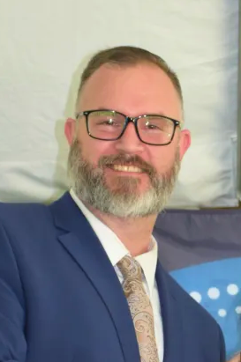
REPORT OF THE SECRETARY
  2024 Members Meeting Minutes
Jon Sanfratello
Assistant Superintendent of Programs
GV BOCES

Slide 4
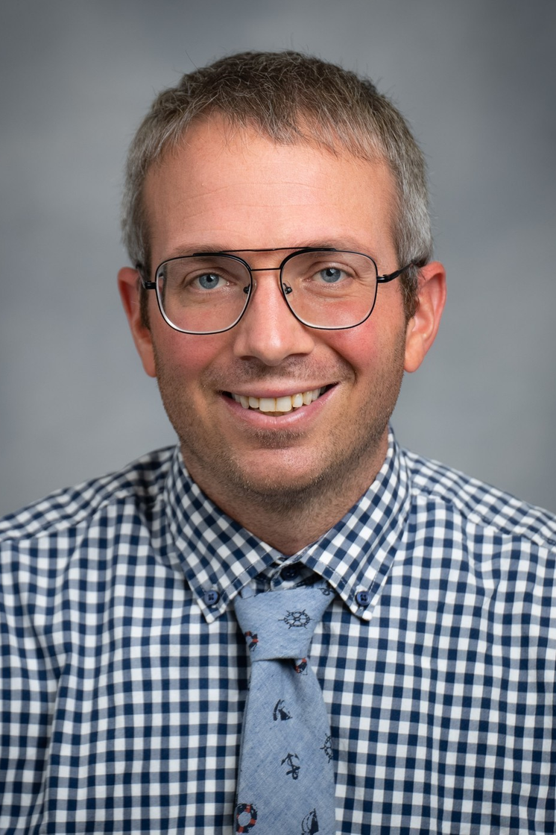
REPORT OF THE TREASURER
  Financial Report
Mike Hoover
Principal
OHM BOCES

Slide 5
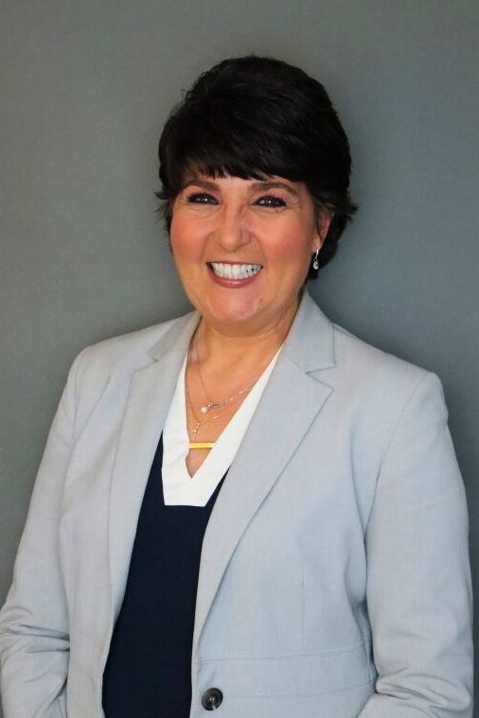
REPORT OF THE VICE PRESIDENT
  ACTEA at the Statewide Level
    Mentoring, Coaching, Teaching
      ACTEA Leadership Conference
      CTE Continuing the Conversation
      Leadership Power Drive
  ACTEA at the Regional Level
    Zone Leadership
      Mentoring and Coaching
      Best Practices across NYS
      Social Media
Michele Friedman
Director of Career and Technical Education
CEWW BOCES

Slide 6
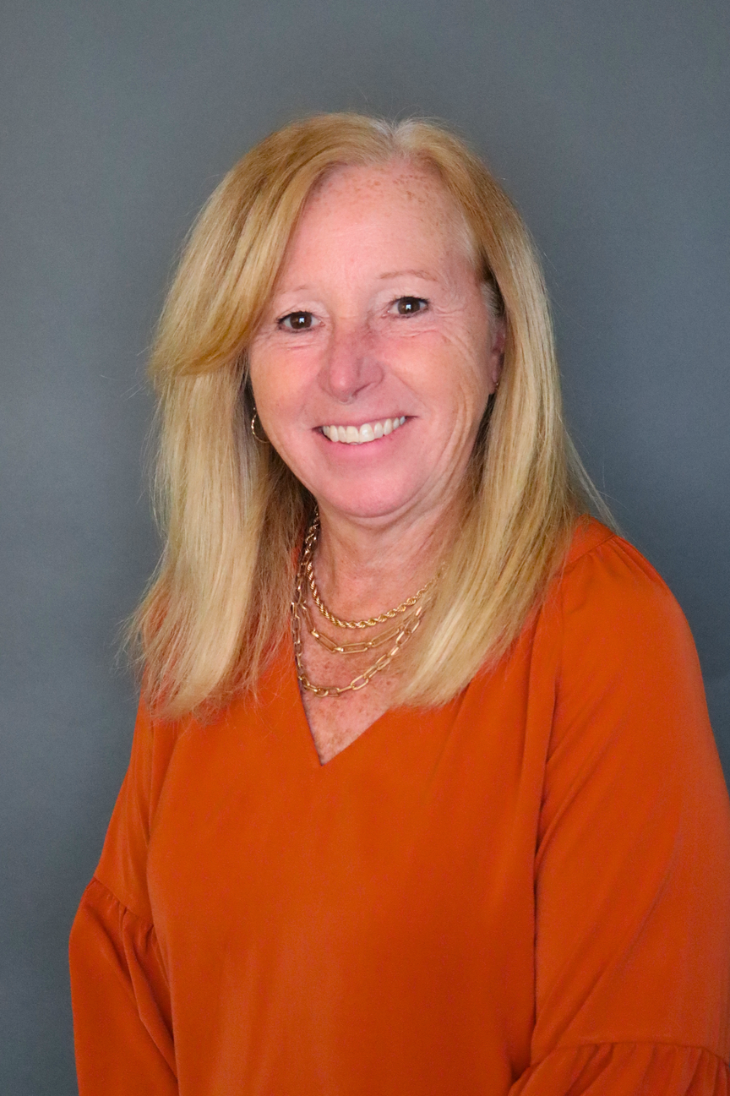
CONGRATULATIONS!
Our Zone 4 ACTEA Board Director
KIM BELL
is retiring!
Kim Bell
Director of Career and Technical Education
Rockland BOCES

Slide 7
ACTEA
NOMINATIONS
Board Election Slate of Officers
Mike Hoover

Slide 8


LEADERSHIP EVENTS
2025-2026
In-Person Conference
OCTOBER 22-24, 2025
New Location!
Turning Stone Resort and Casino
Verona, NY
Matt Sheehan
Director of The Center for Career and Technical Excellence
BT BOCES

Slide 9


2025
THANK YOU!

